Slide 1

Research on Scalable Machine Learning for Fraud Detection using Big Data Technologies
MSc Big Data Analytics: Research Project Presentation
Tarun Singuluri
c4064048@hallam.shu.ac.uk
School of Computing and Digital Technologies
College of Business, Technology and Engineering (BTE)
Sheffield Hallam University
September 2026
TS(SHU)
SCALABLE FRAUD DETECTION
September 2026 1

Slide 2
Acknowledgements
Project Support Recognition
I would like to express my sincere gratitude to my academic supervisor for their valuable guidance, constructive feedback and continuous support throughout this research project. I am also grateful to Sheffield Hallam University and the School of Computing and Digital Technologies for providing the academic environment, technical resources and facilities required to complete this work.
I would also like to acknowledge the availability of the secondary financial transaction dataset, which provided the foundation for the data analysis, machine-learning implementation and evaluation conducted in this research. Finally, I appreciate the support and resources that contributed to the successful development and completion of this project.
TS(SHU)
SCALABLE FRAUD DETECTION
September 2026 2

Slide 3
Presentation Agenda I
1. Introduction
2. Literature Review
3. Research Methodology
4. Ethics
5. Implementation
TS(SHU)
SCALABLE FRAUD DETECTION
September 2026 3

Slide 4
Presentation Agenda II
6. Results
7. Evaluation
8. Conclusion
9. References
10. AI Declaration
TS(SHU)
SCALABLE FRAUD DETECTION
September 2026 4

Slide 5
Introduction: Problem, Context & Rationale
INTRODUCTION
Situation
Complication
Resolution
Rapid growth in online transactions creates high-volume, high-velocity and varied financial data.
Rule-based and manual methods struggle with complex fraud patterns, scale and highly imbalanced data.
Use PySpark distributed processing with ML models to compare predictive performance and computational efficiency.
Why this matters
• Financial institutions need accurate detection without unacceptable processing cost.
• Tree-based models can capture complex patterns, but may require more computation.
• The project therefore treats scalability and efficiency as first-class evaluation criteria.
TS(SHU)
SCALABLE FRAUD DETECTION
September 2026 5

Slide 6
Aim, Objectives, Research Questions & Deliverable
INTRODUCTION
Aim
Develop and evaluate a scalable and efficient fraud detection framework using PySpark-based ML models for large-scale financial transaction data.
Objectives
Research questions
• Preprocess and optimise the dataset using PySpark.
• Develop and compare Logistic Regression, Random Forest and Gradient Boosted Trees.
• Evaluate using precision, recall, F1-score, ROC-AUC and confusion matrices.
• Analyse scalability, processing efficiency and real-time performance.
• What are the benefits of combining scalable ML with big-data technologies for fraud detection?
• Which algorithm performs best when implemented with big-data technologies?
• What impact do big-data frameworks have on computational performance, scalability and processing time?
TS(SHU)
SCALABLE FRAUD DETECTION
September 2026 6

Slide 7
Literature Review: Themes, Contrasts & Research Gap
LITERATURE REVIEW
Theme 1 — ML for Fraud
Theme 2 — Big Data
Theme 3 — Imbalance
Logistic Regression offers simplicity and interpretability; Random Forest and Gradient Boosted Trees model more complex relationships.
Apache Spark/PySpark supports partitioned, parallel processing and structured ML pipelines for large datasets.
Fraud is a minority class; accuracy alone can be misleading, making recall, precision, F1 and ROC-AUC important.
Critical contrast
Higher predictive power ↔ higher computational cost
Research gap
• Limited comparison of fraud models in PySpark that simultaneously considers predictive performance, processing efficiency and scalability.
• The project therefore compares three models under a common distributed framework rather than selecting a model by accuracy alone.
TS(SHU)
SCALABLE FRAUD DETECTION
September 2026 7

Slide 8
Research Methodology: Design & Justification
METHODOLOGY
Secondary
590,540
80/20
3
5+
data source
merged records
train/test split
ML algorithms
core metrics
Methodological structure
Why this approach?
• Quantitative, computational evaluation using a secondary financial transaction dataset.
• Comparative experimental design: the same processed dataset and evaluation criteria are used across three PySpark models.
• Distributed implementation: PySpark + Spark MLlib, with feature transformation and model evaluation in a structured pipeline.
• Multi-metric assessment is justified by the severe class imbalance.
Alternative considered
A single-machine / accuracy-only comparison would not directly test the project's scalability and efficiency objectives.
Alignment
The method directly maps to the aim: preprocess → model → evaluate → measure computational cost and scalability.
TS(SHU)
SCALABLE FRAUD DETECTION
September 2026 8

Slide 9
Ethics: Governance, Data & Risk Management
ETHICS
Data source
Ethics route
Data protection
Secondary data: IEEE-CIS Fraud Detection dataset accessed through Kaggle. No participant recruitment was required for the practical analysis.
The dissertation includes a UREC2 low-risk research ethics proforma. The form records 'No' responses to participant-risk screening questions.
Ethical considerations include responsible handling of financial data, privacy, secure storage and avoidance of biased fraud predictions.
Project risks and mitigations
GDPR / ethical principles
• Class imbalance → fraud-class weighting.
• Data-quality / missing values → explicit preprocessing and categorical encoding.
• Computational constraints → PySpark distributed processing and training-time measurement.
• Reproducibility / code loss → systematic documentation and GitHub version control.
• Privacy and responsible data handling.
• Secure data management.
• Avoidance of biased fraud predictions.
• No human-participant data collection in the implementation.
TS(SHU)
SCALABLE FRAUD DETECTION
September 2026 9

Slide 10
Implementation: System Architecture & Development Flow
IMPLEMENTATION
Dataset
Acquisition
Data
Loading
Data
Inspection
Data
Preprocessing
Feature
Engineering
Exploratory
Analysis
Model
Training
Model
Evaluation
Scalability
Analysis
→
→
→
→
→
→
→
→
Low-level implementation
Model set
• 49 numerical + 15 categorical features selected.
• Missing numerical values replaced with a sentinel; categorical missing values coded as a separate category.
• StringIndexer + OneHotEncoder → VectorAssembler.
• Class weighting assigns greater weight to the fraud class.
• PySpark + Spark MLlib provide the distributed processing and modelling environment.
Logistic Regression
Random Forest
Gradient Boosted Trees
TS(SHU)
SCALABLE FRAUD DETECTION
September 2026 10

Slide 11
Implementation: Data Preparation & Model Setup
IMPLEMENTATION
434
64
14.290
0.518
472,404
columns after join
selected features
fraud-class weight
legitimate weight
training records
Pipeline evidence
Why weighting?
• Transaction and identity datasets were loaded separately and joined using TransactionID.
• The merged dataset contained 590,540 rows and 434 columns.
• Class imbalance: 569,877 legitimate vs 20,663 fraudulent transactions (~3.50% fraud rate).
• The final dataset was split into 472,404 training records and 118,136 testing records.
The fraud class is the minority class. Giving fraudulent observations a higher weight supports detection of the class that matters most to the fraud objective.
Testing evidence
The implementation records model training time and produces accuracy, precision, recall, F1-score and ROC-AUC for comparative evaluation.
TS(SHU)
SCALABLE FRAUD DETECTION
September 2026 11

Slide 12
Results: Dataset Profile & Class Imbalance
RESULTS
590,540
144,233
434
3.50%
transaction rows
identity rows
merged columns
fraud rate
Class distribution
Legitimate — 569,877
Fraud — 20,663
Implication: overall accuracy can look strong while minority-class detection remains weak.
• This motivated class weighting and the use of precision, recall, F1-score, ROC-AUC and confusion matrices.
• The evaluation therefore focuses on fraud-class detection rather than accuracy alone.
TS(SHU)
SCALABLE FRAUD DETECTION
September 2026 12

Slide 13
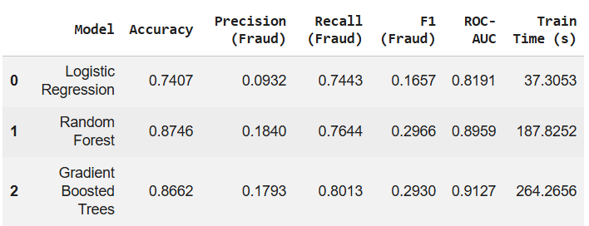
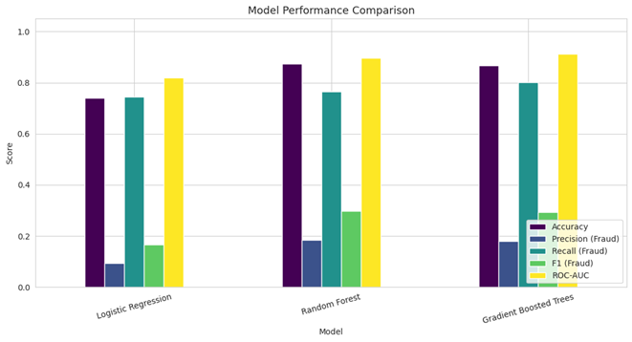
Results: Model Performance Comparison
RESULTS
Logistic Regression
Random Forest
Gradient Boosted Trees
Accuracy 74.07% | Fraud precision 9.32% | Recall 74.43% | F1 16.57% | ROC-AUC 0.8191
Accuracy 87.46% | Fraud precision 18.40% | Recall 76.44% | F1 29.66% | ROC-AUC 0.8959
Accuracy 86.62% | Fraud precision 17.93% | Recall 80.13% | F1 29.30% | ROC-AUC 0.9127
TS(SHU)
SCALABLE FRAUD DETECTION
September 2026 13

Slide 14
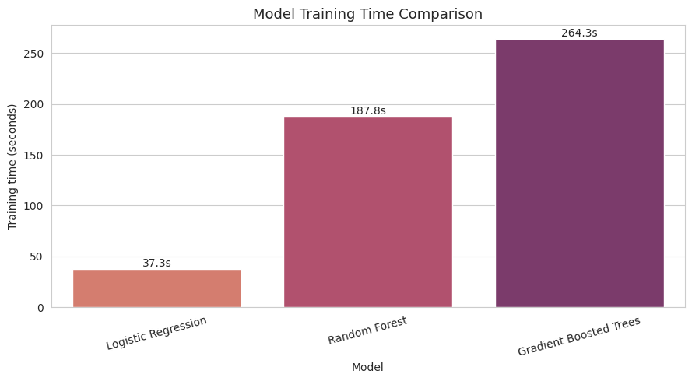
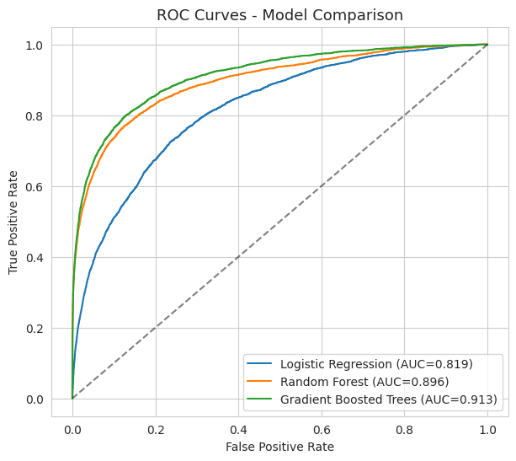
Results: Predictive Performance vs Computational Cost
RESULTS
Training time
Interpretation
• Logistic Regression: 37.31 s
• Random Forest: 187.83 s
• Gradient Boosted Trees: 264.27 s
• GBT provides the strongest discrimination (ROC-AUC 0.9127).
• Logistic Regression is much faster, but its ROC-AUC is 0.8191.
• The project demonstrates a practical trade-off between predictive capability and computation.
TS(SHU)
SCALABLE FRAUD DETECTION
September 2026 14

Slide 15
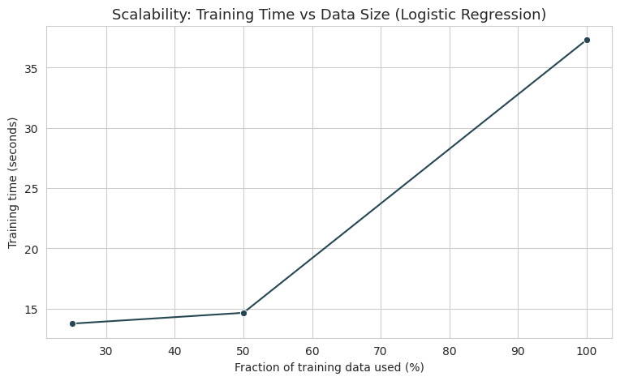
Results & Validation: Scalability and UAT
EVALUATION
User Acceptance Testing
• Dataset loads successfully — Pass
• Preprocessing succeeds — Pass
• All three models train and generate predictions — Pass
• Evaluation metrics generated — Pass
• Confusion matrix displayed — Pass
• Model comparison and training time available — Pass
• Different dataset sizes can be processed/timed — Pass
• GBT identified as highest ROC-AUC model — Pass
Scalability test
Training data fractions of 25%, 50% and 100% were used. The project considered both predictive behaviour and computational efficiency.
Limitation: the dissertation does not document formal external beneficiary testing or formal external user-acceptance results.
TS(SHU)
SCALABLE FRAUD DETECTION
September 2026 15

Slide 16
Evaluation: Objective Alignment, Strengths & Limitations
EVALUATION
Objective completion
Strengths
O1 — PySpark preprocessing
Achieved: preprocessing, encoding, feature assembly and weighting implemented.
Common distributed framework; multi-metric evaluation; explicit class-imbalance treatment; computational cost measured alongside predictive performance.
O2 — Compare 3 models
Achieved: Logistic Regression, Random Forest and GBT trained and compared.
O3 — Multi-metric evaluation
Achieved: accuracy, precision, recall, F1, ROC-AUC and confusion matrix outputs.
Limitations
No documented external beneficiary validation; scalability evidence is based on the tested environment and data fractions; real-time deployment was not demonstrated.
O4 — Scalability/efficiency
Achieved at project-test level: training times and 25/50/100% data-size tests recorded.
Overall judgement
The technical objectives were met, with GBT providing the strongest fraud discrimination but at the highest training cost.
TS(SHU)
September 2026 16
SCALABLE FRAUD DETECTION

Slide 17
Conclusion: Resolution of Gaps & Research Question
CONCLUSION
Gap addressed
Best model
Efficiency trade-off
The project goes beyond accuracy-only comparison by evaluating predictive performance, computational cost and scalability within a PySpark framework.
Gradient Boosted Trees achieved the highest ROC-AUC (0.9127) and fraud recall (80.13%), indicating strongest discrimination.
Logistic Regression trained in 37.31 s, compared with 187.83 s for Random Forest and 264.27 s for GBT.
Answer to the research questions
• Scalable ML + big-data processing can support fraud detection on large transaction datasets.
• GBT provides the strongest overall discrimination among the tested models.
• Distributed processing and model choice affect computational cost; scalability must be assessed alongside predictive performance.
TS(SHU)
SCALABLE FRAUD DETECTION
September 2026 17

Slide 18
Future Prospects & Recommendations
CONCLUSION
Real-time monitoring
Larger datasets
Model expansion
Extend the PySpark framework towards real-time transaction monitoring.
Test on larger and more diverse financial datasets.
Investigate additional ML/deep-learning algorithms and hyperparameter optimisation.
Extreme imbalance
Distributed clusters
Adaptive fraud detection
Explore stronger approaches for severe class imbalance.
Scale to larger computing clusters for stronger scalability evidence.
Automate model retraining to respond to evolving fraud patterns.
Explainable AI
Improve interpretability so analysts can understand fraud predictions.
TS(SHU)
SCALABLE FRAUD DETECTION
September 2026 18

Slide 19
References: Key Sources
REFERENCES
• Alketbi, A. (2025). Real-Time Fraud Detection using Big Data.
• Bello, A., & Olufemi, K. (2024). Artificial intelligence in fraud prevention: Exploring techniques and applications and challenges and opportunities. Computer Science & IT Research Journal, 5(6), 1505–1520.
• Cheng, C. (2025). Research on Fraudulent Transaction Detection. Applied and Computational Engineering, 158(1), 35–40.
• Gupta, R., Jindal, R., Naik, A., & Tripathi, A. (2025). Applying Logistic Regression for the Detection of Fraudulent Banking Transactions.
• Hareram, S. E. (2025). Technical Review: Apache Spark and PySpark for Distributed Data Processing.
• Liu, C., Tang, H., Yang, Z., Ke, Z., & Cha, S. (2025). Big Data-Driven Fraud Detection Using Machine Learning and Real-Time Stream Processing.
• Naghipour, S. A., Far, & Nazari, R. (2025). Fraud Analytics with Big Data: A Literature Review on Machine Learning Algorithms in Bankruptcy Prediction and Financial Fraud Detection.
• Owen, A., Emma, O., & Adams, R. (2024). Evaluating the Role of Class Imbalance in Fraud Detection Algorithms.
• Theodorakopoulos, L., Theodoropoulou, A., Tsimakis, A., & Halkiopoulos, C. (2025). Big Data-Driven Distributed Machine Learning for Scalable Credit Card Fraud Detection Using PySpark, XGBoost, and CatBoost. Electronics, 14(9), 1754.
• Wiltshire, D., & Alvanides, S. (2022). Ensuring the ethical use of Big Data: lessons from secure data access. Heliyon, 8(2).
APA-style details reproduced from the dissertation reference list; full URLs/DOIs are retained in the written report.
TS(SHU)
SCALABLE FRAUD DETECTION
September 2026 19

Slide 20
AI Declaration: Transparency Statement
AI DECLARATION
AITS alignment
AI-supported activities
Human contribution
The dissertation states that AI tools were used as a supporting resource during preparation, consistent with transparent academic use.
Clarity and structure of writing; language and grammar checking; organising ideas; refinement of academic wording.
The research topic, objectives, methodology, analysis, interpretation and conclusions were developed and critically evaluated by the student.
Academic integrity position
• AI-assisted content was reviewed, verified and edited before inclusion.
• Academic claims were independently sourced and referenced.
• AI was not used as a replacement for independent critical thinking or academic judgement.
• Responsibility for accuracy, originality, integrity and final content remains with the student.
TS(SHU)
SCALABLE FRAUD DETECTION
September 2026 20

Slide 21
Thank You!
Questions & Academic Discussion Welcome
Research on Scalable Machine Learning for Fraud Detection using Big Data Technologies
TS(SHU)
September 2026 21
SCALABLE FRAUD DETECTION

